Slide 1
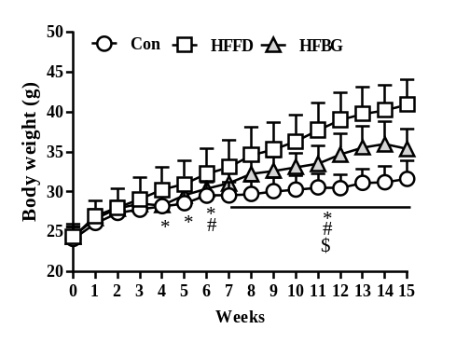
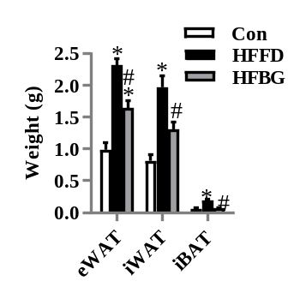
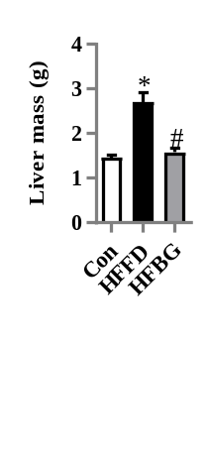

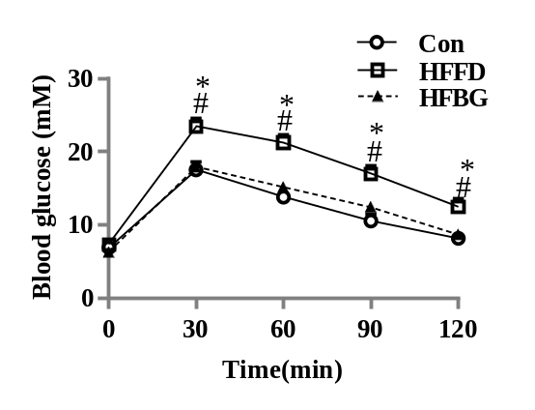
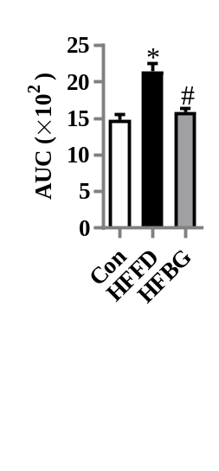
Fig S1
A
Con
HFFD
HFBG
B
C
Con
HFFD
HFBG
D
E
Figure S1. High-fat and fibre-deficient (HFFD) diet induced metabolic syndrome in mice, which were to some degree attenuated by β-glucan supplementation. (A) Body weight over time (n=15). (B) Fat pad weight (n=9). (C) liver mass (n=9). Glucose tolerance test with blood glucose levels were measured at the indicated time point (D) and area under curve (AUC) calculated (E) (n=10). Values are mean ± SD (A); Values are mean ± SEM (B-I). *p < 0.05 HFFD vs. Control (Con). #p <0.05 HFBG vs. HFFD. $p <0.05 HFBG vs. Con. Scale bar: 50μm. eWAT: epididymal white adipose tissue; iWAT: inguinal white adipose tissue; iBAT: interscapular brown adipose tissue.

Slide 2
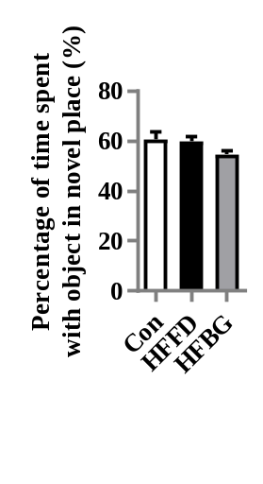
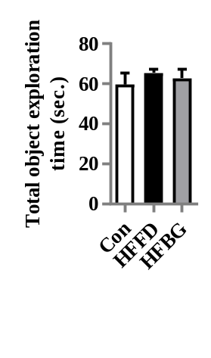
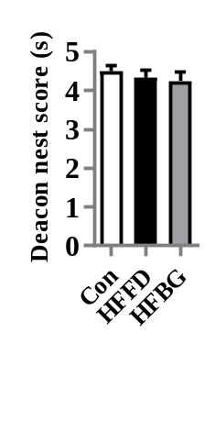
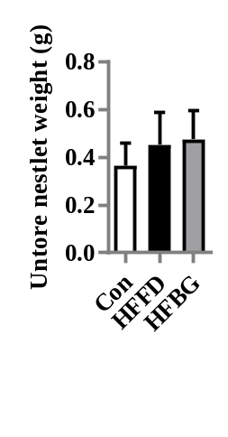
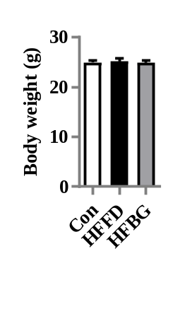
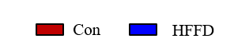
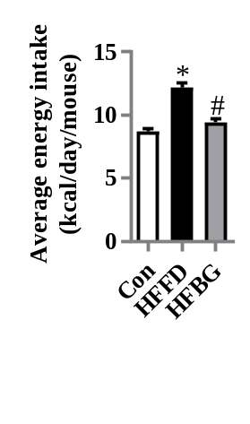
Fig S2
A
B
C
D
E
F
D
G
Firmicutes
Enterococcaceae
Enterococcus
Lactobacillales
Bacilli
Clostridia
Clostridiales
Lachnospiraceae
Allobaculum
Saccharibacteria
Blautia
Prevotellaceae_UCG_001
Roseburia
Gordonibacter
Christensenellaceae
Ruminococcaceae_UCG_014
Gastranaerophilales
Cyanobacteria
Ruminococcaceae_NK4A214_group
Pasteurellaceae
Pasteurellales
Haemophilus
Mollicutes_RF9
Acetatifactor
Mollicutes
Tenericutes
Christensenellaceae_R_7_group
Coprococcus_1
Christensenellaceae
Burkholderiaceae
Nocardiaceae
Rhodococcus
Corynebacteriales
Paraburkholderia
Ralstonia
Eisenbergiella
FCS020_group
Pseudomonadales
Prevotella_7
Pseudomonas
Pseudomonadaceae
Xanthomonadaceae
Stenotrophomonas
Xanthomonadales
Moraxellaceae
Acinetobacter
Selenomonadales
Veillonella
Negativicutes
Veillonellaceae
Brevinema
Brevinemataceae
Streptococcaceae
Streptococcus
Campylobacteraceae
Arcobacter
Alloprevotella
Prevotellaceae
Alistipes
Rikenellaceae
Proteobacteria
Enterobacteriales
Enterobacteriaceae
Klebsiella
Gammaproteobacteria
Bacteroidetes
Bacteroidia
Bacteroidales
LDA SCORE (log 10)

Slide 3
Fig S2. Acute β-glucan (HFBG) administration for 7 days did not affect body weight and cognitive behaviours in mice. (A) Percentages of time spent with the object in the novel place to total object exploration time. (B) Total object exploration time. (C) Nest score. (D) Untorn nesting material. (E) Body weight. (F) Average energy intake. (G) Linear discriminant analysis (LDA) effect size showing the most differentially significant abundant taxa enriched in microbiota from the control (Con) vs. HFFD. *p < 0.05 vs. Control (Con). #p < 0.05 vs. high-fat and fibre-deficient (HFFD).

